Slide 1


The Structure of R
Notes:
You’ll notice I named this session “Poke the Box”, which I think is a productive mentality when approaching a new programming language.
The basic mentality: TRY STUFF – see what happens. What can we learn?
We’ll start by looking at some (maybe painfully) basic input & output, and talk about what insights we can gain.

Slide 2
Base R
The core language and built in functionality of R
You can do quite a lot with Base R, but it reads like a programming language (not always intuitive)
Let’s write a Base R script and see what we can do
Notes:
Go into what Base R is here. Do a bunch of stuff from Matt’s code.

Slide 3
R Programming Basics, in Base R
- Poke the Box! -
Notes:
You’ll notice I named this session “Poke the Box”, which I think is a productive mentality when approaching a new programming language.
The basic mentality: TRY STUFF – see what happens. What can we learn?
We’ll start by looking at some (maybe painfully) basic input & output, and talk about what insights we can gain.

Slide 4
Easy Things with Numbers
- Poke the Box! -
Notes:
You’ll notice I named this session “Poke the Box”, which I think is a productive mentality when approaching a new programming language.
The basic mentality: TRY STUFF – see what happens. What can we learn?
We’ll start by looking at some (maybe painfully) basic input & output, and talk about what insights we can gain.

Slide 5
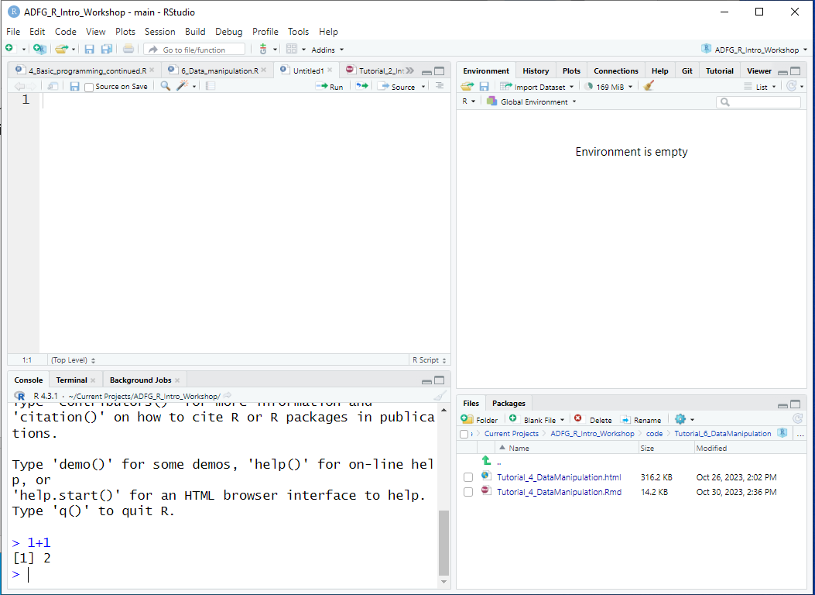
Poke the box R console!
There was a “>” with a flashing cursor after it
I typed this and hit Enter
> 1+1
[1] 2
R printed this!
You can ignore the [1] thing for now
Notes:
Can’t get more basic than this
Here’s an RStudio window, and zooming in on the Console…

Slide 6
Poke the box R console!
Insights…
R does math!
  For now, you can think of it as a fancy calculator
1+1
[1] 2
Notes:
Already, there are some insights!
--
R does math … which is reassuring
--
You can even think of R like a calculator: Each line can be its own operation, which takes the pressure off! You don’t have to write a complete “program” to see results

Slide 7
Poke the box R console!
Insights…
R does math!
R ignores whitespace between things
  You can space things out for readability
1+1
[1] 2
1 + 1
[1] 2
Notes:
What do you see about the DIFFERENCES in how these two lines evaluated?
What does that tell us?

Slide 8
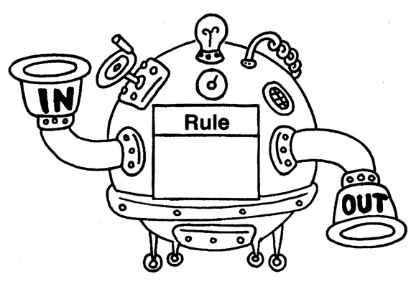
Poke the box R console!
Insights…
R does math!
R ignores whitespace between things
Base R has some built-in functions
  Things that go inside the parentheses (function inputs) are referred to as “arguments” of the function
1+1
[1] 2
1 + 1
[1] 2
sqrt(49)
[1] 7
Notes:
How about this line? What happened? (it took the square root of 49!)
--
Maybe more generally, R uses FUNCTIONS.
--
Here’s a little bit of R terminology: the inputs (or … stuff that go inside the parentheses) are referred to as ARGUMENTS

Slide 9
Poke the box R console!
Insights…
R does math!
R ignores whitespace between things
R uses functions
R is case-sensitive
Errors happen!!!
  YOUR COMPUTER WILL NOT EXPLODE
  “Errors are not problems, just puzzles” (Error messages might be clues)
1+1
[1] 2
1 + 1
[1] 2
sqrt(49)
[1] 7
Sqrt(49)
Error in Sqrt(49) : could not find function "Sqrt"
Notes:
What does this tell us? Case sensitivity.
--
But, maybe a MORE important insight: ERRORS HAPPEN! And with every error, we get a message that might give us some clues as to what went wrong
Note: the “could not find function” probably just means something is spelled wrong (or in this case, capitalized wrong)

Slide 10
Poke the box R console!
meaningOfLife <- 42
meaningOfLife
[1] 42
meaningOfLife + 1
[1] 43
What do you think will happen?
Notes:
How about these TWO lines? What happened?
--
Meaning of life, adjusted for inflation?

Slide 11
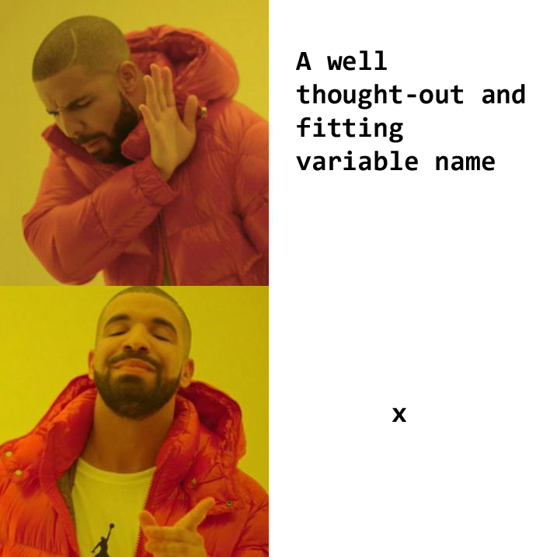
Poke the box R console!
Insights…
You can store variables using “<-”
  Sometimes people say “gets” as verbal shorthand
  Terminology: this is sometimes referred to as an assignment statement
You can make names descriptive
meaningOfLife <- 42
meaningOfLife
[1] 42
meaningOfLife + 1
[1] 43
Notes:
--
… you can store variables using this angle bracket hyphen thingy that looks like a leftward arrow…

Slide 12

What if I have more than one number?
First, a few new tools:
The c( ) function can be used to construct a vector, that is, an ordered set
  Don’t worry, functions that read data directly from .csv, .txt, xlsx, etc. will be introduced soon!
c(1, 1, 2, 3, 5, 8)
[1] 1 1 2 3 5 8
Notes:
Ok, we stored one number … but you’ve probably got a lot more than that!
Introducing the c() function (c for concatenate)
…and this is an important enough concept that it gets its own name. If it’s helpful, you can think of a vector as being like ONE COLUMN of a spreadsheet.
And by the way: you won’t have to type stuff by hand like this very often: Most of the time you’ll be reading data from an external file.
BUT it’s worth looking at some simplified examples first, so you’ll have an intuition for how things will behave once it’s read INTO R.

Slide 13
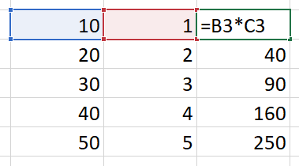
Introducing vector operations…
The most basic structure in R is a vector
Many (most) operations in R can be evaluated vector-wise
What does this mean?
a <- c(10, 20, 30, 40, 50)
b <- c(1, 2, 3, 4, 5)
a * b
[1] 10 40 90 160 250
Mental model for Excel users:
Notes:
… so here’s a silly example
… we get a vector OUT, and check out how this works:
If it’s useful, you can think of this like dragging a formula down in Excel – and just like Excel, the RELATIVE POSITION gets preserved

Slide 14
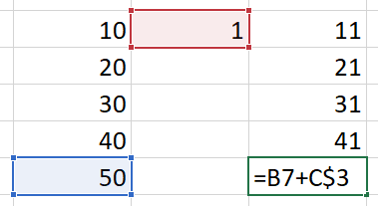
Introducing vector operations…
The most basic structure in R is a vector
Many (most) operations in R can be evaluated vector-wise
What does this mean?
What happens when you mix vectors and single numbers?
a <- c(10, 20, 30, 40, 50)
b <- c(1, 2, 3, 4, 5)
a * b
[1] 10 40 90 160 250
a + 1
[1] 11 21 31 41 51
Mental model for Excel users:
Notes:
I can hear you thinking, what happens when you mix vectors and single numbers?
… you get a vector out, but it adds one to ALL elements
So maybe this is how it works in Excel land?

Slide 15
What if I have more than one number?
First, a few new tools:
The c( ) function can be used to construct a vector, that is, an ordered set
The : operator can be used to construct a sequence of integers
c(1, 1, 2, 3, 5, 8)
[1] 1 1 2 3 5 8
2014:2023
[1] 2014 2015 2016 2017
[5] 2018 2019 2020 2021
[9] 2022 2023
Insight…
That weird [1] thing we keep seeing? It’s just R labeling where each line of output starts!
Notes:
Here’s a couple more ways of making a vector from scratch…
Another tool is the colon operator, which makes an integer sequence
also sounds like a laxative XD
Oh, and remember that [1] thing in square brackets we kept seeing? Now what do you think it means?
It’s just saying where each line of printed output starts!

Slide 16
What if I have more than one number?
First, a few new tools:
The c( ) function can be used to construct a vector, that is, an ordered set
The : operator can be used to construct a sequence of integers
The seq( ) function can be used to construct a custom sequence
c(1, 1, 2, 3, 5, 8)
[1] 1 1 2 3 5 8
2014:2023
[1] 2014 2015 2016 2017
[5] 2018 2019 2020 2021
[9] 2022 2023
seq(from=0, to=1, by=0.2)
[1] 0.0 0.2 0.4 0.6 0.8 1.0
seq(from=0, to=1, length.out=6)
[1] 0.0 0.2 0.4 0.6 0.8 1.0
Insights…
There are often multiple ways to do the same thing in R
Functions can have multiple possible arguments
Notes:
The seq() function…
Now before you try memorizing all the different arguments you see here, I actually want to call attention to two things:
- there’s often multiple ways of doing the same thing
- functions can have multiple possible arguments

Slide 17
Other Data Types
- Poke the Box! -
Notes:
You’ll notice I named this session “Poke the Box”, which I think is a productive mentality when approaching a new programming language.
The basic mentality: TRY STUFF – see what happens. What can we learn?
We’ll start by looking at some (maybe painfully) basic input & output, and talk about what insights we can gain.

Slide 18
We just learned about the ways you can manipulate and store numbers in R
But what about other things that aren’t numbers?
R has several other data types that you can manipulate in similar ways to numbers!

Slide 19
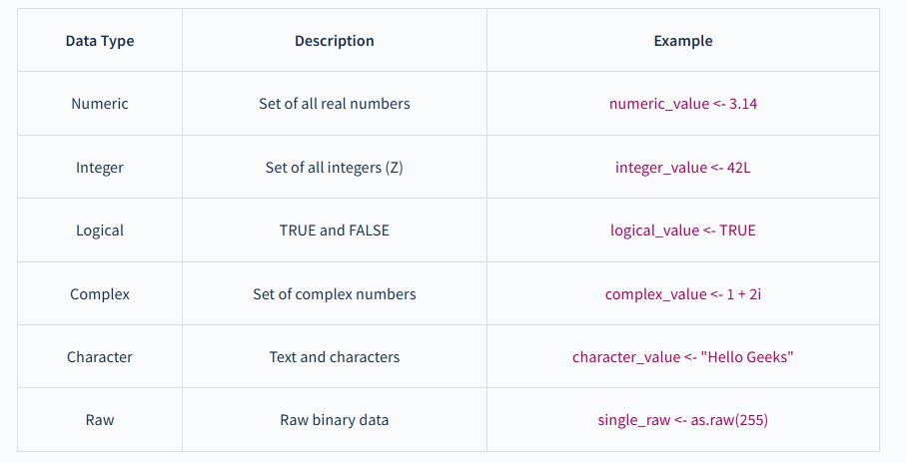

Slide 20
Classes of vectors: R can store different kinds of information
Less complex
 | Possible values | can be used in mathematical expressions
logical | FALSE or TRUE (or NA) | yes
numeric | all numbers (or NA / NaN / Inf) | yes
character | most combinations of letters, numbers, and special characters (or <NA>) | no
Can be changed into a different class without losing information
More complex
Notes:
So far we’ve just seen numbers, but R can also store other things
Logical is simpler, it can only be TRUE or FALSE
With Character, you can store text
And things can be changed into a MORE COMPLEX class without losing information. …which will make sense in a moment.

Slide 21
Classes of vectors
myName <- "Inigo Montoya"
1 + "Bob"
Error in 1 + "Bob": non-numeric argument to binary operator
"2" + 4
Error in "2" + 4: non-numeric argument to binary operator
heres_a_logical_vector <- c(TRUE,
FALSE, TRUE, FALSE, TRUE)
heres_a_logical_vector
[1] TRUE FALSE TRUE FALSE TRUE
Title looks scary, but
It’s actually pretty obvious what can & can’t happen
Insights…
Quotes in an assignment statement tell R to interpret something as character
  Note: " " and ' ' can both be used as long as you’re consistent on both sides
R knows what TRUE and FALSE mean without quotes
Notes:
But first … it’s generally pretty intuitive what can and can’t happen…
Notice that wrapping “2” in quotes tells R to treat it as Character

Slide 22
So what did I mean about changing classes?
Less complex
logical
numeric
logical
numeric
character
c(TRUE, FALSE, TRUE, FALSE, 5)
[1] 1 0 1 0 5
More complex
The result becomes numeric
Notes:
…lets look at what happens here

Slide 23
So what did I mean about changing classes?
Less complex
logical
numeric
logical
numeric
character
c(TRUE, FALSE, TRUE, FALSE, 5)
[1] 1 0 1 0 5
More complex
The result becomes numeric
Insights
All elements of a vector will be the same class!
Hey look, you can use whole vectors as arguments in c( )
numeric
character
c(seq(2, 8, by=2), "Who do we appreciate")
[1] "2" "4" "6" "8" "Who do we appreciate"
The result becomes character
Notes:
Maybe more importantly….
…and I put this one in bold because this is DIFFERENT FROM EXCEL!

Slide 24
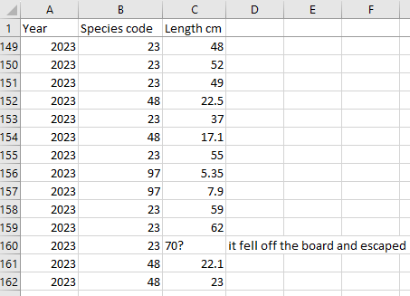
Why do we care???
Take-home messages:
  Different classes (types of data) exist!
  R can do different things with different classes
  R may do things you didn’t intend
Will become numeric
Will become character
Notes:
So to bring it all home, just remember:
--
Side note: this is one of THE most common data errors!
Personal favorite: number with a trailing space (someone pranking the biometrician??)

Slide 25
Btw: yes, we can change classes manually
smellsLikeSchoolSpirit <- c(seq(2, 8, by=2), "Who do we appreciate")
smellsLikeSchoolSpirit
[1] "2" "4" "6" "8" "Who do we appreciate"
as.numeric(smellsLikeSchoolSpirit)
[1] 2 4 6 8 NA
Warning message:
NAs introduced by coercion
Notes:
And I can feel you asking: YES, we can change classes manually. Mostly.
…so here we see this Character vector we made a couple slides ago
And when we turn it back to numeric, it doesn’t know what to do with the last element

Slide 26
One last vector class: factor
Like character, but with a guest list!
rating_char <- c("Low","Medium","High","Low","Medium")
rating_factor <- as.factor(rating_char)
rating_char
[1] "Low" "Medium" "High" "Low" "Medium"
rating_factor
[1] Low Medium High Low Medium
Levels: High Low Medium
as.numeric(rating_factor)
[1] 2 3 1 2 3
Insights
R will probably try to alphabetize your factor levels (High will come before Low and Medium)
Not super important, just an oddity to be aware of!
Notes:
One last vector class that can be useful if you’re working with DISTINCT CATEGORIES is Factor
So we created a vector two ways: look at the difference in how R behaves
- the Factor version carries another piece of information: what categories are allowed
And this is a little odd: R will actually let you convert factor to numeric

Slide 27
When to use character?
When to use factor?
There are no specific categories of interest
Fields are open-ended
Examples…
  Comments
  Personnel?
  Weather?
There are distinct categories
  Probably related to a research question!
You’d like to do formal testing/plotting using these categories
Examples…
  Species (code)
  Sex
  Age?
  Year??
Might be numeric, depending on context!
In practice:
R will import non-numeric columns as character by default (as of 2020), rather than factor
  That’s a good thing, it’s easier to make changes to character variables than factor!
R will generally treat character as factor when it needs to (ANOVA, boxplots, chi-squared tests, …)
  So the distinction doesn’t matter as much as it used to
But, data summaries can be easier with factor, so it’s often worth converting character to factor
  …after editing values, if that’s needed
Notes:
This might feel like splitting hairs, but since we’re talking about the differences, we should probably talk about when to use which.
But IN PRACTICE, it actually matters a little less than it might seem

Slide 28
Simple Functions
- Poke the Box! -
Notes:
You’ll notice I named this session “Poke the Box”, which I think is a productive mentality when approaching a new programming language.
The basic mentality: TRY STUFF – see what happens. What can we learn?
We’ll start by looking at some (maybe painfully) basic input & output, and talk about what insights we can gain.

Slide 29
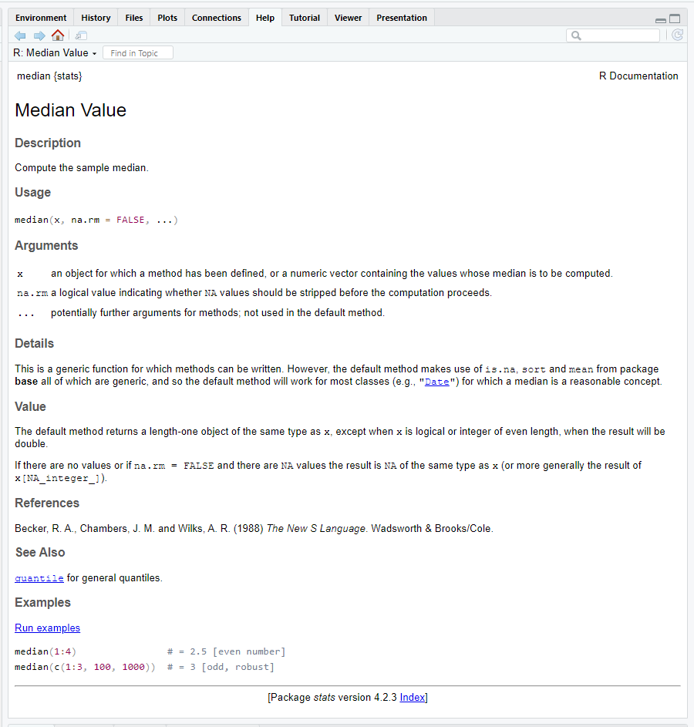
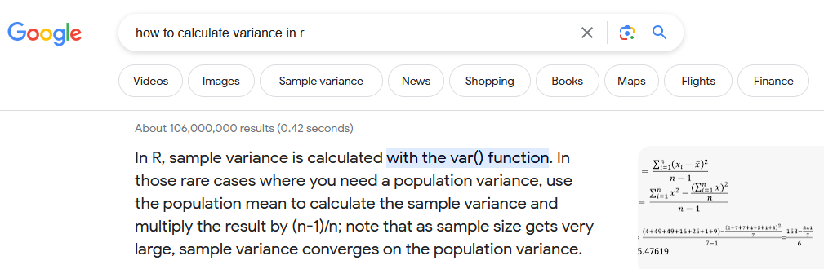
Help!
?median
help("median")
Notes:
And thankfully, you don’t have to memorize all the things, because there is HELP!

Slide 30
Some operators & functions…
The usual cast of characters: +, -, *, /, ^
1+2*3-4^5/(6-7)
[1] 1031
1+(2*3)-((4^5)/(6-7))
[1] 1031
Insights…
You can use parentheses in mathematical operations, too
R is pretty smart about order of operations (but I’m still nervous to trust it!)
Notes:
Ok, so let’s build the vocabulary a little.
We have all the math things: addition, subtraction, multiplication, division, and exponents
We can also use parentheses as needed when we’re doing math

Slide 31
Some operators & functions…
The usual cast of characters: +, -, *, /, ^
sqrt(), log(), exp(), abs()
1+2*3-4^5/(6-7)
[1] 1031
1+(2*3)-((4^5)/(6-7))
[1] 1031
sqrt(c(0, 1, 4, 9, 16, 25, 36))
[1] 0 1 2 3 4 5 6
Insight…
Mathematical functions can generally be evaluated vector-wise
Notes:
A few more math things: square root, log, exponential, absolute value
Notice that when we put a vector in, we get a vector out.
You’ll also notice we had to tell R that it was a vector! How did we do that?

Slide 32
Some operators & functions…
The usual cast of characters: +, -, *, /, ^
sqrt(), log(), exp(), abs()
sum(), prod()
mean(), median(), quantile(), sd(), var()
1+2*3-4^5/(6-7)
[1] 1031
1+(2*3)-((4^5)/(6-7))
[1] 1031
sqrt(c(0, 1, 4, 9, 16, 25, 36))
[1] 0 1 2 3 4 5 6
median(c(0, 1, 4, 9, 16, 25, 36))
[1] 9
Insight…
Some functions need a vector input!
Notes:
A few more math things that only make sense with a vector input
Sum, product, mean, median, quantile, standard deviation, and variance
There’s more, this is just a few examples

Slide 33
Let’s talk about NA
a <- c(1, 2, 3, 4, NA)
b <- c(2, 4, 6, 8, 10)
a + b
[1] 3 6 9 12 NA
mean(a)
[1] NA
mean(a, na.rm = TRUE)
[1] 2.5
An NA is a placeholder for an unknown value
Blank cells in spreadsheets are typically imported as NA
R will generally return NA or Error when NA is used in calculations
  Which is good!
  There are ways around this, if appropriate
Notes:
An important R thing we need to talk about is NA, which is R’s way of handling blanks.
--
What happens when we try to take a mean of a vector that contains a missing value? Well, we don’t KNOW what the mean is!

Slide 34
More Functions: Non-numeric data types
- Poke the Box! -
Notes:
You’ll notice I named this session “Poke the Box”, which I think is a productive mentality when approaching a new programming language.
The basic mentality: TRY STUFF – see what happens. What can we learn?
We’ll start by looking at some (maybe painfully) basic input & output, and talk about what insights we can gain.

Slide 35
List <- c(“dog”, “cat”, “pig”)
dog<- “dog”
cat<- “cat”
Length(list) : returns the number of elements in a vector
Paste(dog, cat): concatenates strings/characters
nchar(dog): counts number of characters in a string

Slide 36
X<- c(1,NA,3)
bools<-c(TRUE, TRUE, FALSE)
is.na(x) : returns a list of Booleans (FALSE, TRUE, FALSE) to detect missing values
all(bools) : checks to see if all elements in a logical list are TRUE

Slide 37
BASE R = BUILDING BLOCKS!

Slide 38
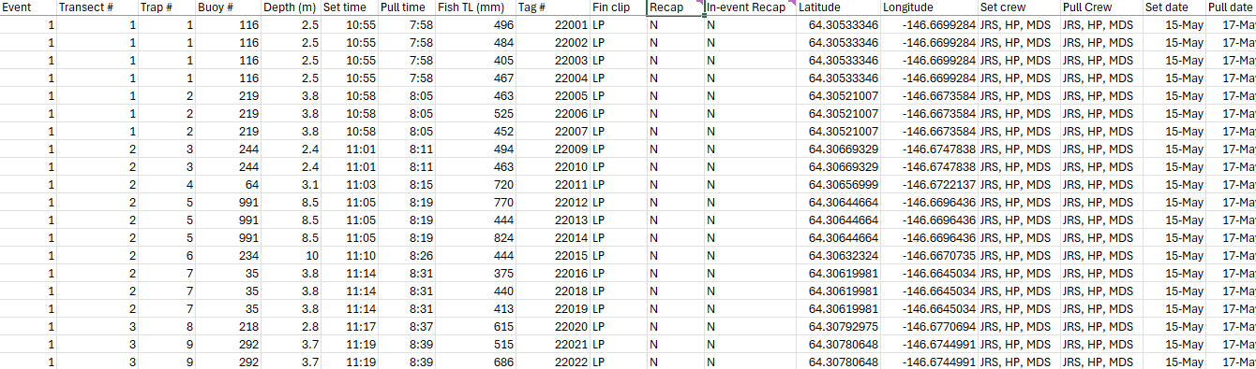
How does this all relate to the Data we are used to?

Slide 39
We have studied Vectors already
If we look at a data table in excel and we deconstruct it by column, doesn’t it look like just a bunch of vectors concatenated together?
That’s what makes up a more complex data structure, which in R we call a dataframe!
Let’s go through step by step how we transform vectors into dataframes.

Slide 40
Vectors: data in one dimension
x <- seq(from=10, to=100, by=10)
x
[1] 10 20 30 40 50 60 70 80 90 100
x[9]
[1] 90
x[c(1, 4, 9)]
[1] 10 40 90
x[-(1:5)]
[1] 60 70 80 90 100
Insights
Square brackets [ ] let you refer to a vector element by its index (think: which mailbox slot)
Passing a vector into [ ] gives a vector output
Negative indices exclude these elements
R gives you clues: [ ]
Notes:
Ok, we’ve seen vectors, which is just data IN ORDER, and that’s what I mean by one dimension.
And square brackets (which is a special character we’ve seen) let us grab a SUBSET of a vector
Notice that a single number in the square brackets pulls out a single number, and a vector in the square brackets pulls out a vector

Slide 41
Vectors: data in one dimension
x <- seq(from=10, to=100, by=10)
x
[1] 10 20 30 40 50 60 70 80 90 100
x[1] <- 999
x
[1] 999 20 30 40 50 60 70 80 90 100
x[6:10] <- 999
x
[1] 999 20 30 40 50 999 999 999 999 999
Insights
You can also assign things using indices!
…and to multiple elements by putting a vector in [ ]
Notes:
And you can also use indices in square brackets to make assignments to subsets of a vector
Check out what happens here

Slide 42
Introducing matrices: Double the dimensions, double the fun!
A <- matrix(1:6, nrow=2, ncol=3)
A
[,1] [,2] [,3]
[1,] 1 3 5
[2,] 2 4 6
A[1, 3] # row 1, column 3
[1] 5
A[, 1] # all of column 1
[1] 1 2
A[2, ] # all of row 2
[1] 2 4 6
A[, 2:3] # columns 2 and 3
[,1] [,2]
[1,] 3 5
[2,] 4 6
Insights
Similar rules apply, except with row and column indices
Use a comma between row and column
Leaving a row or column index empty will select everybody in that dimension
  Matt will often be heard at his desk muttering “Row 42, column ALL…”
Output will be vector OR matrix, depending on input
R gives you clues: [ , ]
Column numbers
Row numbers
Notes:
Ok, the next step towards something that would actually look like data is called a MATRIX.
Now we have rows AND columns, so we need to account for that.
NOTICE that when we print matrix A, it gives us some clues as to how to take it apart
So you can refer to a single element by its row AND column, with a comma in between
OR you can grab a whole row or column … or multiple rows or columns

Slide 43
Introducing matrices: Double the dimensions, double the fun!
A <- matrix(1:6, nrow=2, ncol=3)
A
[,1] [,2] [,3]
[1,] 1 3 5
[2,] 2 4 6
A[1, 1] <- 999 # row 1, column 1
A
[,1] [,2] [,3]
[1,] 999 3 5
[2,] 2 4 6
A[, 3] <- 999 # all of column 3
A
[,1] [,2] [,3]
[1,] 999 3 999
[2,] 2 4 999
Insights
You can assign things using indices in [ ], with the same rules we just saw!
Notes:
And just like with vectors, you can use indices in square brackets to assign stuff!

Slide 44
Introducing data.frames: It’s beginning to look a lot like data!
myfirstdf <- data.frame(sex = c("Male", "Male", "Female"),
length = c(110, 112, 90),
weight = c(3, 3.4, 2.4),
age = c(2, 2, 1))
myfirstdf # looking at the whole thing
sex length weight age
1 Male 110 3.0 2
2 Male 112 3.4 2
3 Female 90 2.4 1
myfirstdf[, 1] # selecting a column
[1] "Male" "Male" "Female"
myfirstdf[1, ] # selecting a row
sex length weight age
1 Male 110 3 2
myfirstdf[1, 1] # selecting a single element
[1] "Male"
Insights
data.frames can have a different class (numeric, character, etc.) for each column!
You can extract rows or columns of a data.frame just like with a matrix
  This will give you either a vector or a data.frame as output
Notes:
I actually introduced matrices so I could talk about data.frames
The VAST MAJORITY OF THE TIME, this is what you’ll be working with!
You’ll notice that the same rules apply

Slide 45
Introducing data.frames: It’s beginning to look a lot like data!
myfirstdf <- data.frame(sex = c("Male", "Male", "Female"),
length = c(110, 112, 90),
weight = c(3, 3.4, 2.4),
age = c(2, 2, 1))
myfirstdf # looking at the whole thing
sex length weight age
1 Male 110 3.0 2
2 Male 112 3.4 2
3 Female 90 2.4 1
myfirstdf$sex # selecting a column by name
[1] "Male" "Male" "Female“
myfirstdf$age[3] <- 999
myfirstdf
sex length weight age
1 Male 110 3.0 2
2 Male 112 3.4 2
3 Female 90 2.4 999
Insights
New rule: the $ operator selects something by name!
You can combine $ with [ ] and use the same rules we’ve already seen
The $ selects by name!
Selection by name
Assignment by index
Notes:
And an EVEN BETTER WAY to get to columns of a data.frame is by NAME, using the dollar sign operator
And this is a big one, so we’ll put it in bold.

Slide 46
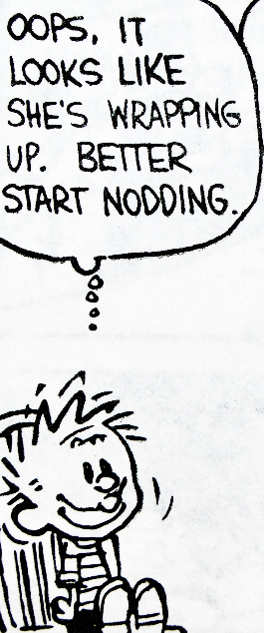
Concepts to take away from this session:
R does math!
1+2*3-4^5/(6-7)
[1] 1031
1+(2*3)-((4^5)/(6-7))
[1] 1031
Notes:
Alright! Let’s revisit the main points we saw.

Slide 47
Concepts to take away from this session:
R does math!
R uses functions with multiple possible arguments (inputs)
sqrt(49)
[1] 7
median(c(1, 1, 2, 3, 5, NA), na.rm=TRUE)
[1] 2

Slide 48
Concepts to take away from this session:
R does math!
R uses functions with multiple possible arguments (inputs)
You can store results in variables that you create
  Note: these go away when you close R, but that’s a good thing
N_hat <- (n1 + 1)*(n2 + 1)/(m2 + 1) – 1
myNameIs <- c("Inigo Montoya", "Slim Shady", "Ozymandias")

Slide 49
Concepts to take away from this session:
R does math!
R uses functions with multiple possible arguments (inputs)
You can store results in variables that you create
  Note: these go away when you close R, but that’s a good thing
R uses vectors (ordered sets) and does most operations vector-wise
vector
vector
single number (actually a vector of length 1)
c(1, 2, 3) * c(10, 20, 30) + 5
[1] 15 45 95
vector

Slide 50
Concepts to take away from this session:
R does math!
R uses functions with multiple possible arguments (inputs)
You can store results in variables that you create
  Note: these go away when you close R, but that’s a good thing
R uses vectors (ordered sets) and does most operations vector-wise
There are different classes of vectors (logical, numeric, character, factor) for storing different types of information
Don’t worry about memorizing this, it’s just for reference!
Class | Possible values | Can it math?
logical | FALSE or TRUE (or NA) | yes
numeric | all numbers (or NA / NaN / Inf) | yes
factor | most combinations of letters, numbers, and special characters from a defined set (or <NA>) | no
character | most combinations of letters, numbers, and special characters (or <NA>) | no
Can be changed into a different class without losing information
FALSE = 0, TRUE = 1

Slide 51
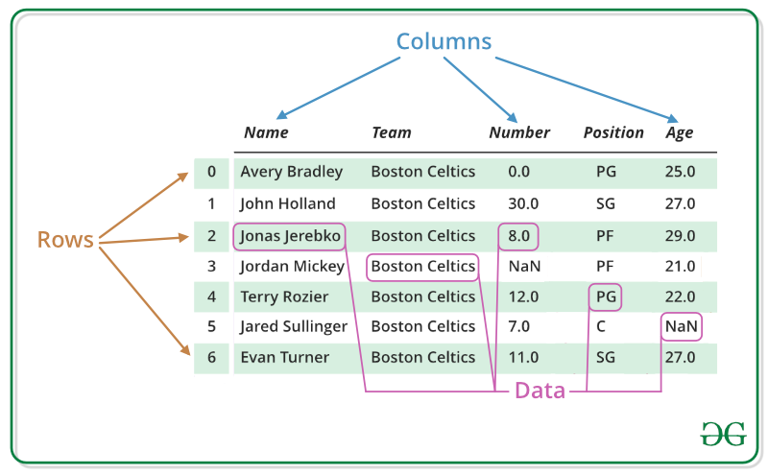
Concepts to take away from this session:
All of these things can come together to store data in DATA FRAMES!

Slide 52
Base R is the BUILDING BLOCKS!

Slide 53
But What is Base R Practically Good for
Software Development
Simulations
Time efficiency
Advanced Statistics
Collaboration
Flexibility
Low Dependencies
EXCELLENT FOR PROGRAMMING

Slide 54
Do you need these things in your work?
Software Development
Simulations
Time efficiency
Advanced Statistics
Collaboration
Package Development
Debugging
EXCELLENT FOR PROGRAMMING

Slide 55
What are Packages?
Packages contain functions that help us do things without having to write a ton of code
Let’s write an example script together to look at how this works
Notes:
- Write a script for computing moving averages with base R and moving averages with zoo package

Slide 56
What are our goals in R?
Results From the Survey You Took indicate
Summarize data and Calculate Statistics
Data manipulation
Importing and Cleaning data
Data visualization

Slide 57
Does Base R fit our needs?
Summarize data and Calculate Statistics
Data manipulation
Importing and Cleaning data
Data visualization
It technically could, but we would have to use a lot of confusing syntax and build a lot of our own functions

Slide 58
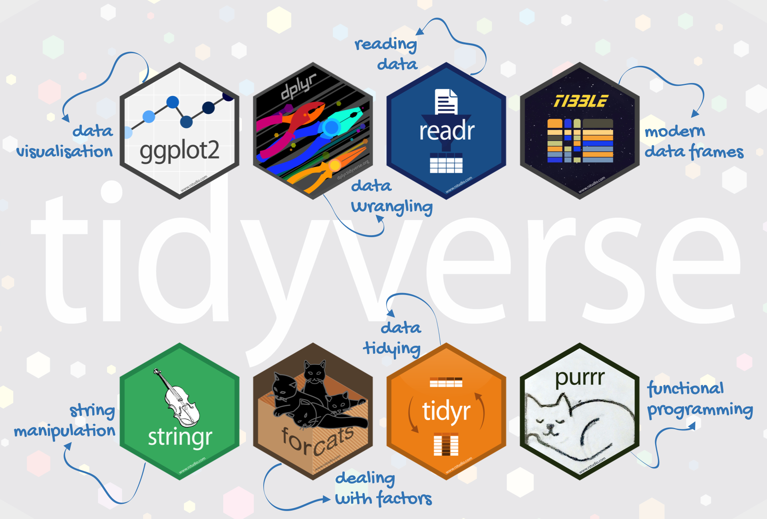
Is there another solution?

Slide 59
Tidyverse
Collection of Packages that are useful for data analysis and visualization
We will be using a few in particular to tackle our goals
Summarize data and Calculate Statistics → DPLYR
Data manipulation → DPLYR
Importing and Cleaning data → READR
Data visualization → GGPLOT2
Notes:
After this,

Slide 60
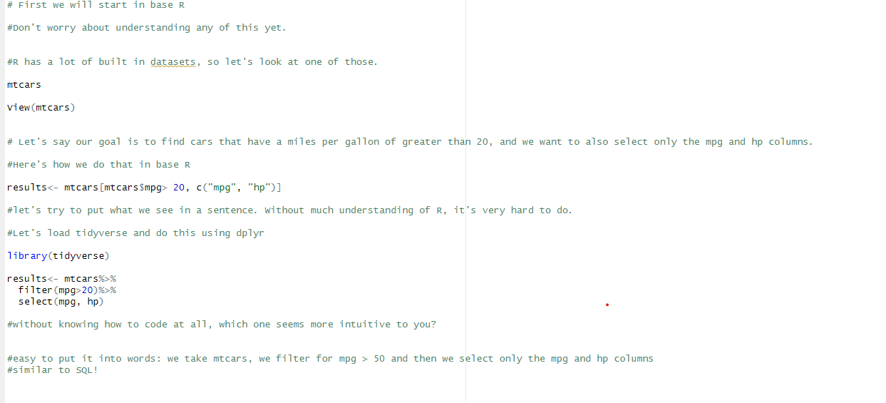
Tidyverse or base R?
Notes:
After this, go over to the IDE to walk through this example with everyone.

